Slide 1

WHAT IS CLOUD?
Let’s assume that you are watching a cloud in the sky. but have you ever thought that you can watch the same cloud anywhere in your location. This is how it works, you can access the data/application via the internet at any time in anyway.

Slide 2

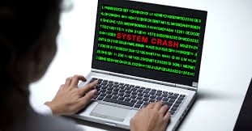

Why Cloud?
If you are working on a project for 30 days and you saved all your data on your local PC. But unexpectedly your PC got broken. You lost all Project data.
NOTE:
Whenever you saved your data in a physical device like memory Cards, CDs, and Pen drives. If you lost these devices or if the devices gets crashed them the data should not be retrieved.

Slide 3
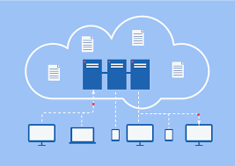
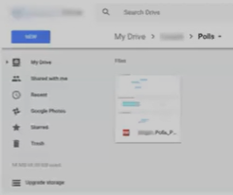
But what if you saved all your files in to cloud.
Now even if you lose your files now , no need to worry about data. Because all your files and folders are securely stored in the cloud.

Slide 4
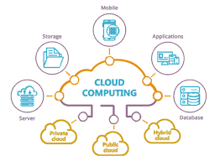
What is Cloud Computing
Cloud Computing is the delivery of computing services like
Servers, Storage, Database, Networking and Software.
or
It is the processing of accessing the data or application via the internet.

Slide 5
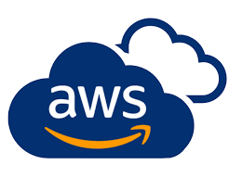
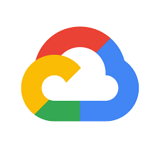

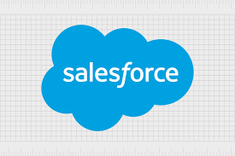
Types of Cloud Computing

Slide 6
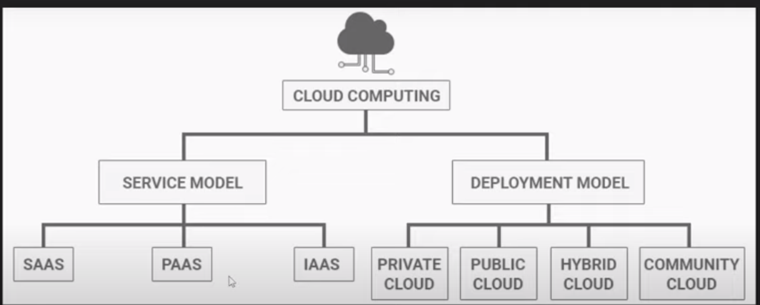

Slide 7
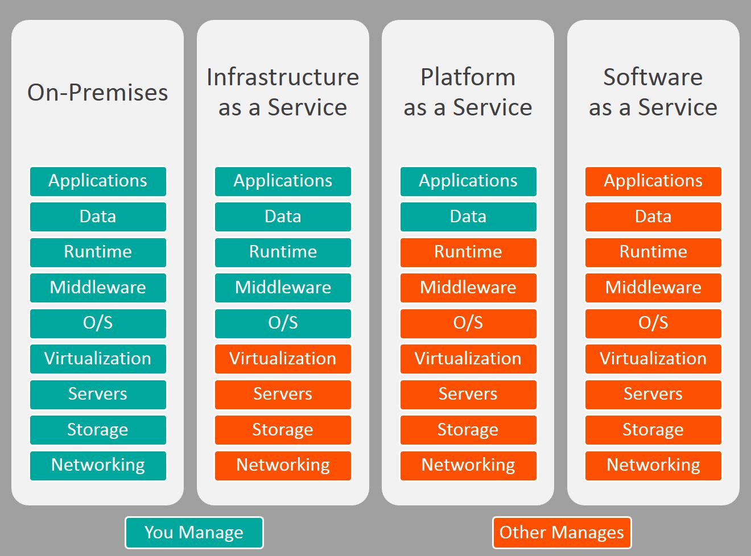
Service Model:

Slide 8
Infrastructure as a Service(Iaas): In this model, the cloud provider offers virtualized computing resources such as virtual machines, storage and networking to customers.
Platform as a Service(Paas):This model provides a Platform for customers to develop, run, and manage their own applications, without having to worry about the underlying infrastructure.
Software as a Service(Saas): This model provides software application that are hosted and managed by the cloud provider, and can be accessed by users over the internet.

Slide 9
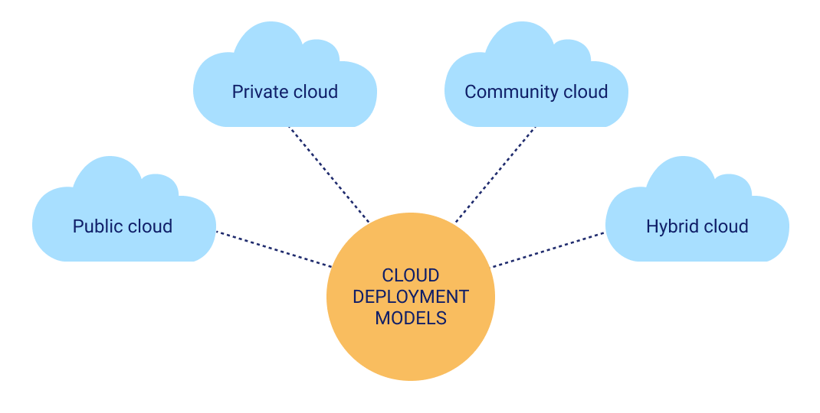
Deployment Model:

Slide 10
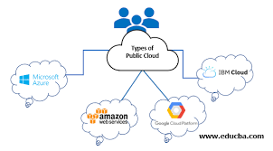
Public Cloud:
Public cloud is open to all to store and access information via the Internet. Public clouds are managed by third Parties. In public Cloud, Security will be less when we compared to private and hybrid.

Slide 11
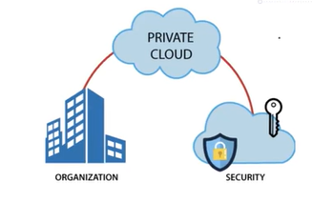
Private Cloud:
A Private Cloud Is also known as an internal cloud or corporate cloud. It is used by organizations to build and manage their data Centers . In private cloud security will be high.

Slide 12
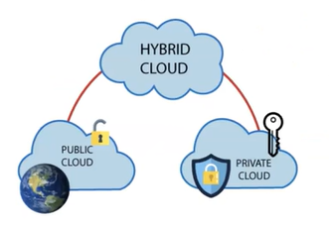
Hybrid Cloud:
Hybrid cloud is the Combination of both Public and private cloud. If the services are running on public then it will not have much Security. If the services are running on private then the cloud have high Security.

Slide 13

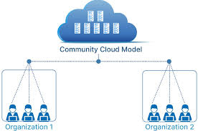
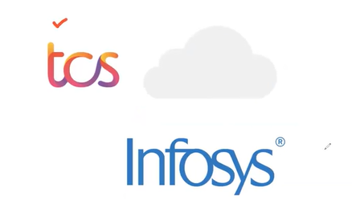

Community cloud:
It allows multiple Organizations to use some Cloud to store their data.

Slide 14
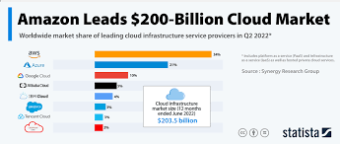

Slide 15
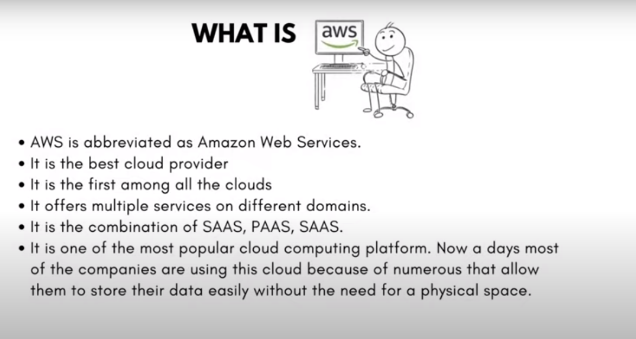

Slide 16
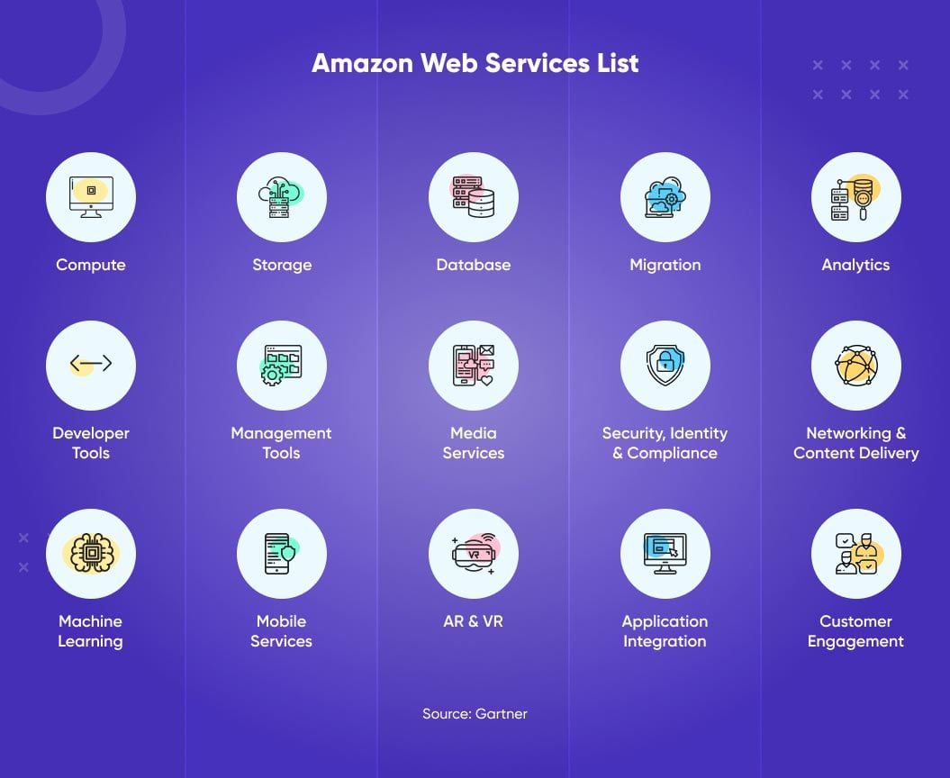

Slide 17
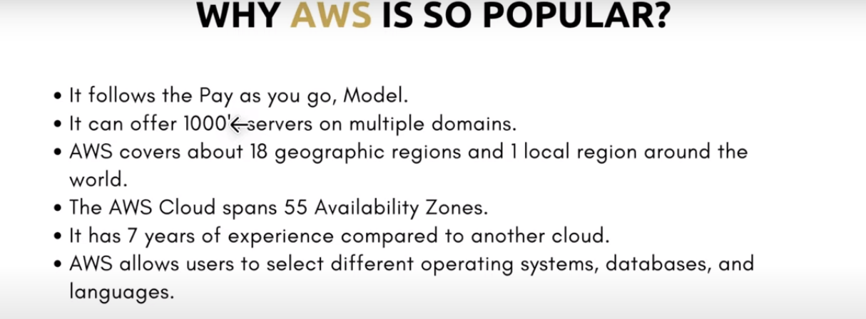

Slide 18
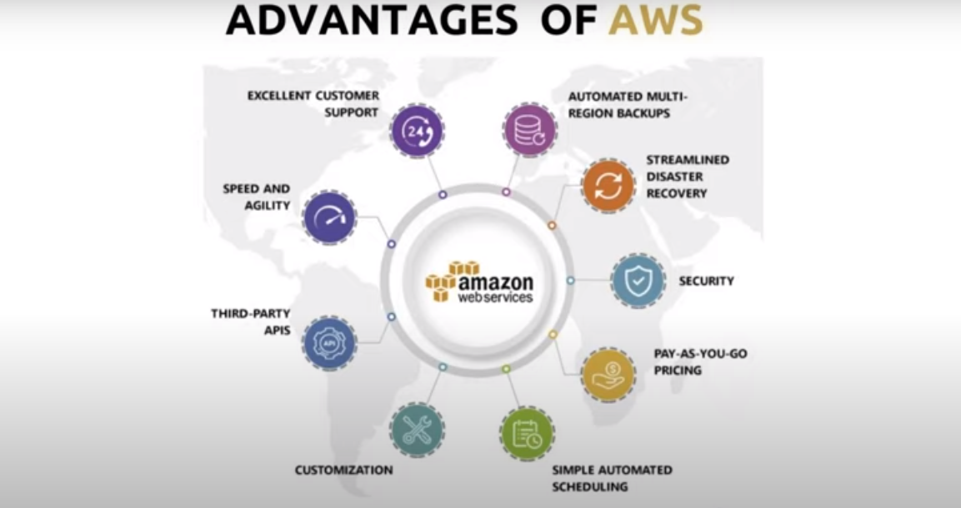

Slide 19
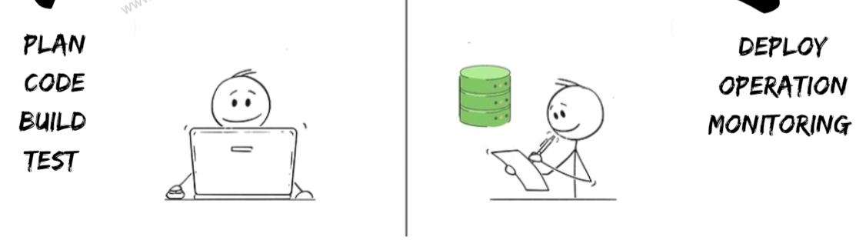
What is DevOps
In Software Domain , we have 2 teams for developing the Application.
Development
Operation

Slide 20
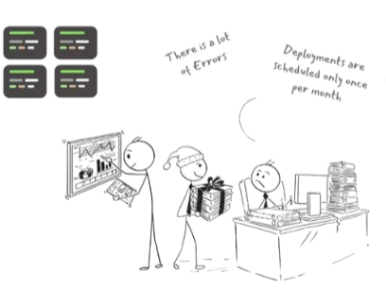
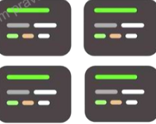


Development
Operation
The DEV Team writes the code for the entire application and tosses it to operational team for Production.
The OPS Team Deploys, Monitor Operate & Maintain the application.

Slide 21
DevOps is Not a Tool, technology or Frame Work
DevOps is a Cultural Movement, mindset, Philosophy to coordinate produce better , more reliable Products
By automating infrastructure, workflow, and continuously measuring application performance for which they use a lot of tools.

